Slide 1



Four Ways to get Vapor Pressure
Short Cut Method
Approximation
Clausius-Clapyron
Equation
Use Peng-Robinson or other EOS and find where the fugacity ratio is 1
Antoine
Equation
Which method depends on accuracy needed, availability of parameters, and calculation speed required. For Clausius- Clapron Equation you can use
1) ecentricity, 2) critical point, 3) normal boiling point as reference points.
We want to know the vapor pressure to determine fractionation at vapor/liquid equilibria in Chapter 10 for multicomponent systems

Slide 2
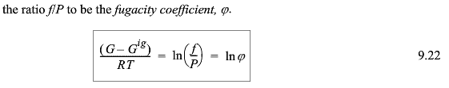



Gibb’s Free Energy decides phase equilibria at constant T and P
-SUV
H A
-pGT
dG=-SdT + VdP (depends on T and P)
G^{L} = G^{V} at equilibrium
dG = VdP (Constant T)

Slide 3
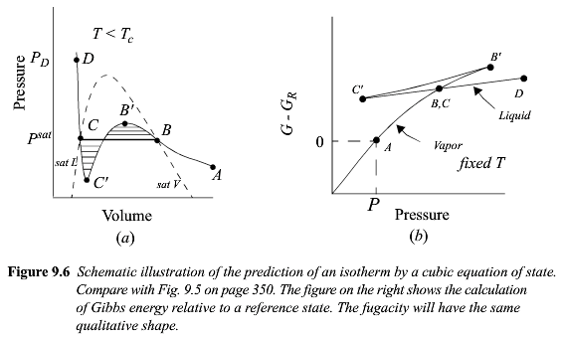
Vapor/Liquid Equilibria From EOS

Slide 4



-SUV
H A
-pGT

Slide 5
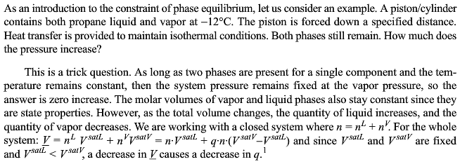



Slide 6
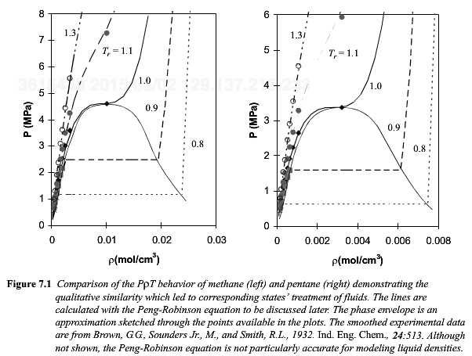

Slide 7
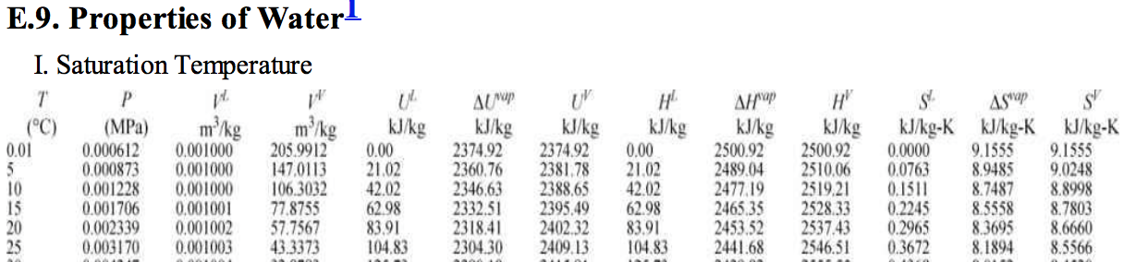
At 25°C pure liquid G = 105 kJ/kg – 298°K 0.367 kJ/kg°K = -4 kJ/kg
pure vapor G = 2547 kJ/kg – 298°K 8.56 kJ/kg°K = -4 kJ/kg
-SUV
H A
-pGT
G = H - TS

Slide 8
-SUV
H A
-pGT
We have two equations for the free energy at the equilibrium point, a definition of G and the derivative equation
ΔH^{vap} can be measured, as can T, P and V
dG = VdP – SdT
At V/L Equilibria
dG^{L} = dG^{V}
V^{V}dP^{sat} – S^{V}dT = V^{L}dP^{sat} – S^{L}dT
(V^{V}-V^{L}) dP^{sat} = (S^{V}-S^{L}) dT
Also
G = H - ST
At equilibrium ΔG^{vap} = 0
T^{vap} = ΔH^{vap} / ΔS^{vap}
From above
dP^{sat}/dT = ΔH^{vap}/(T(V^{V}-V^{L}))

Slide 9
-SUV
H A
-pGT
dP^{sat}/dT = ΔH^{vap}/(T(V^{V}-V^{L}))
dP^{sat}/dT = ΔH^{vap}/(TV^{V})
dP^{sat}/dT = PΔH^{vap}/(Z^{V}RT²)
dP^{sat}/dT = P^{sat}ΔH^{vap}/(RT²)
(dP^{sat}/P^{sat}) = (ΔH^{vap}/R)(-dT/T²)
d(lnP^{sat} ) = -ΔH^{vap}/R d(1/T^{sat})
ln(P^{sat}/P^{sat}_{ref}) = ΔH^{vap}/R (1/T^{sat} – 1/ T^{sat}_{ref})
ΔH^{vap} can be measured, as can T, P and V
P and T are easier to measure than V so first assume V^{V} >>> V^{L}
Write in terms of Z^{V}= PV^{V}/RT which is 1 at low pressures
Rearrange and use calculus
So plot lnP^{sat} vs 1/T^{sat} to get ΔH^{vap}
Clapyron Equation (i. g.)
For constant ΔH^{vap} integrate
Clausius Clapyron Equation (i.g, constant ΔH^{vap)}

Slide 10
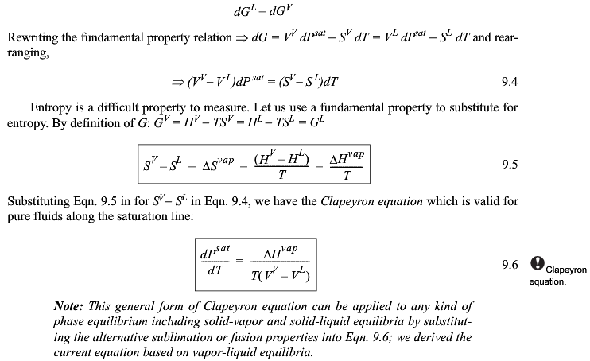

Slide 11
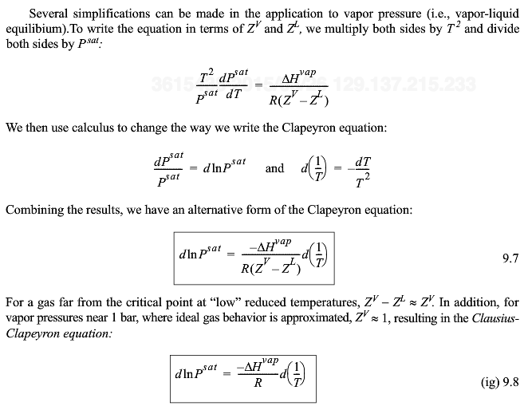
The slope of a plot of lnP_{sat} versus 1/T is -∆H_{vap}/R (for ideal gas approximation)

Slide 12
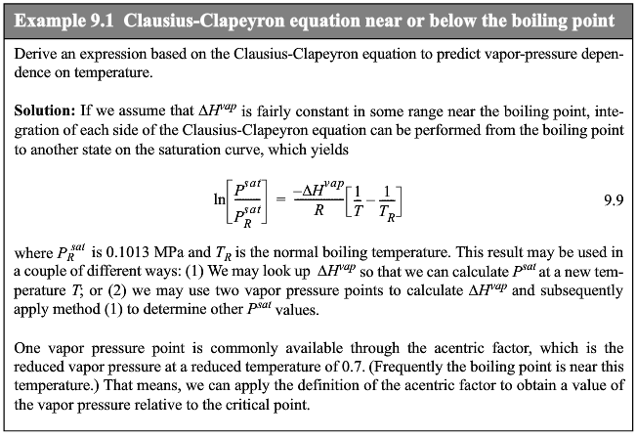

Slide 13



Slide 14


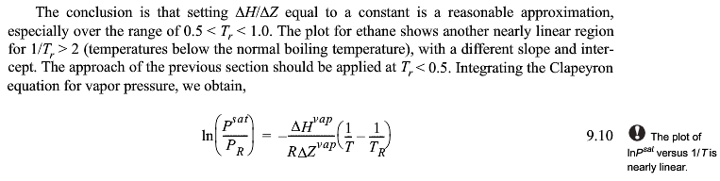
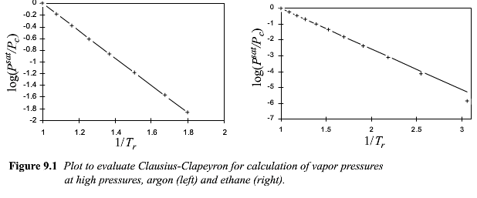

Slide 15

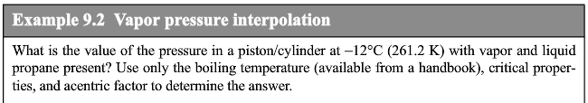
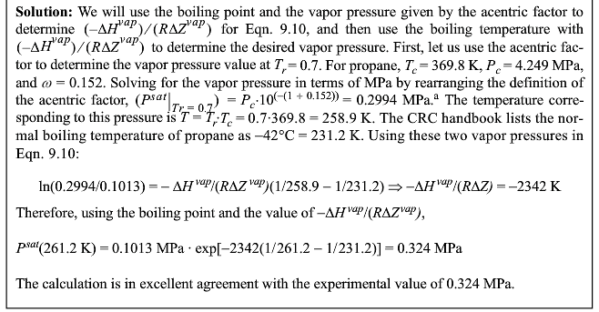

Slide 16
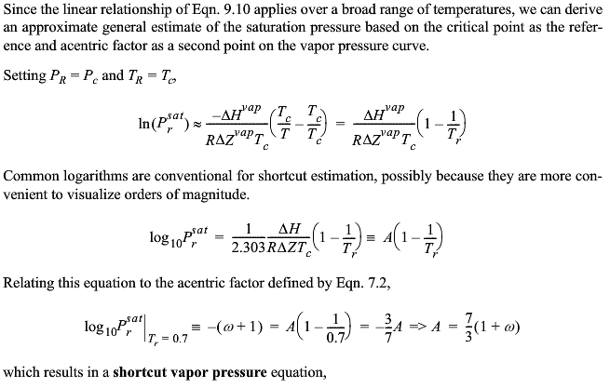
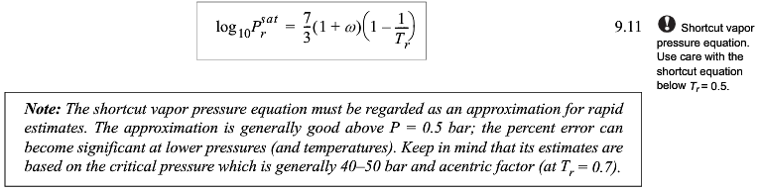

Slide 17

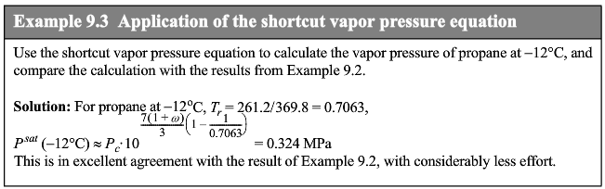

Slide 18
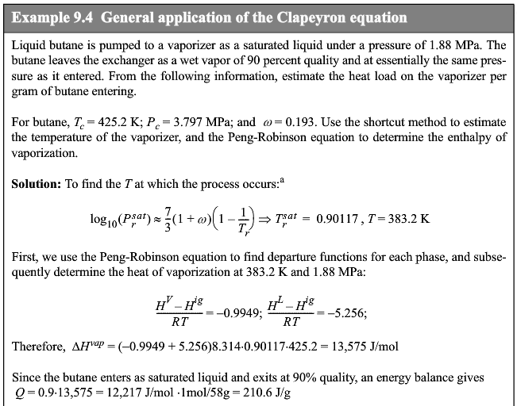

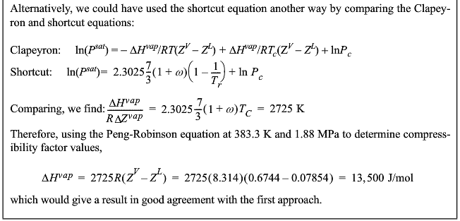

Slide 19
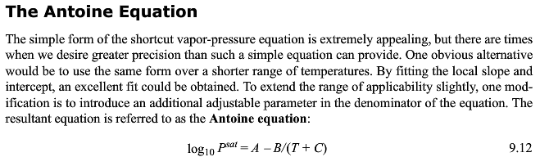

Slide 20
Four Ways to get Vapor Pressure
Short Cut Method
Approximation
Clausius-Clapyron
Equation
Use Peng-Robinson or other EOS and find where the fugacity ratio is 1
Antoine
Equation
Which method depends on accuracy needed, availability of parameters, and calculation speed required. For Clausius- Clapron Equation you can use
1) ecentricity, 2) critical point, 3) normal boiling point as reference points.

Slide 21

-SUV
H A
-pGT

Slide 22
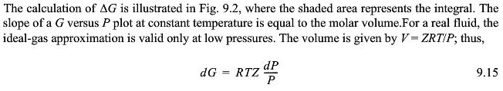
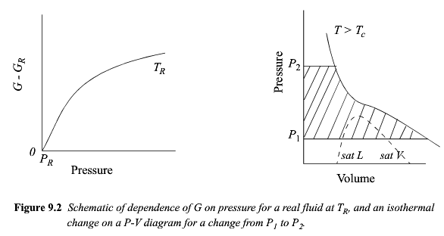

dG/dP = V

Slide 23


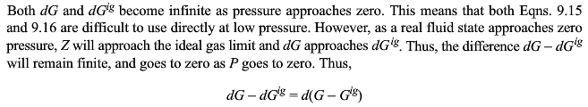

Slide 24
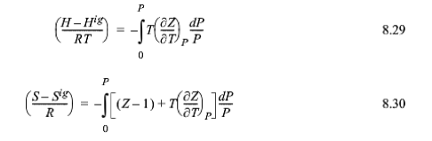
Pressure Dependent Formulas
-SUV
H A
-pGT
G = H - ST

Slide 25
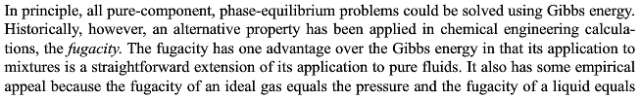


Slide 26
Arrhenius (1859-1927) Function:
Probability = exp(-ΔE/kT) or = exp(-ΔE/RT)
Gives the probability of an event happening if the event is thermally activated; i.e. if the probability changes with the temperature.
Viscosity = Viscosity₀ exp(- ΔE_{a}/kT) Flow happens when atoms thermally move out of the way with an activation energy ΔE_{a}
Vapor Pressure = P₀ exp(-ΔE_{vap}/kT) Antoine equation
ΔE_{vap} = ΔH_{vap} – T ΔS_{vap}
P_{sat} = P₀ exp(A – B/(T+C)) A = – ΔS_{vap}/R B = ΔH_{vap} C = Temp for no P_{sat}
Entropy prob. = exp(-S/R) Energy with no enthalpy (Boltzman equation)
Fugacity
f/P = exp((G-G^{ig})/RT) = probability of a molecule escaping from a phase
G = H - TS is a measure of the balance between enthalpic attractions and thermally driven dispersion of the molecules. So f is a measure of the dispersibility of a phase, the more dispersible the less stable. Lower fugacity is the more stable phase.
Arrhenius accurately predicted global warming due to CO₂ in a paper published in 1896 which was widely read. His calculations were within 10% of current global temperature rises.

Slide 27


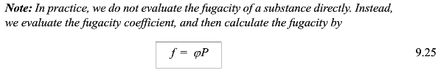

Slide 28
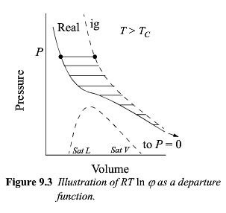
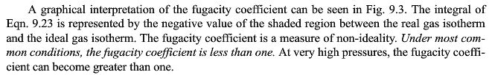

Slide 29
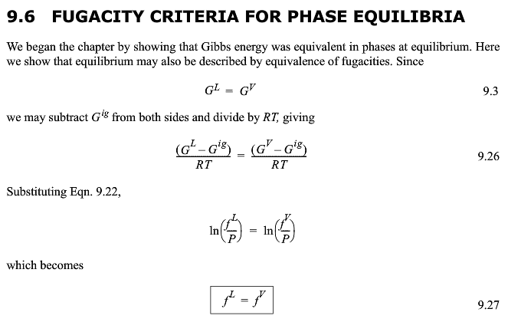
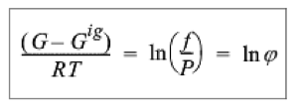

Slide 30

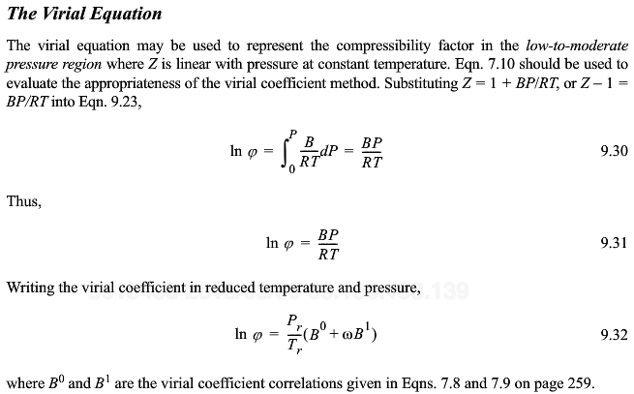

Slide 31
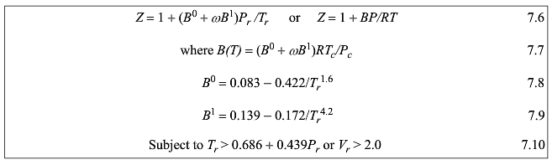

Slide 32
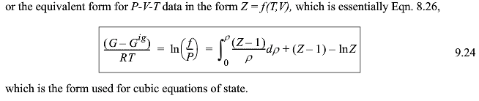



Slide 33
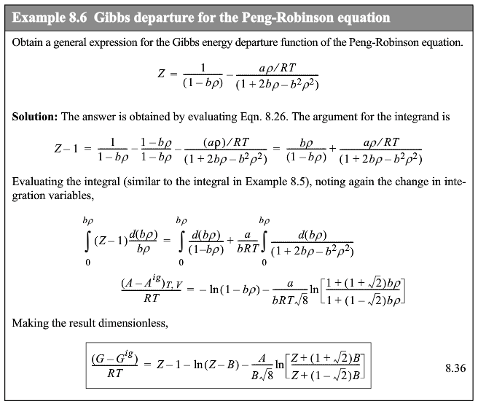


Slide 34

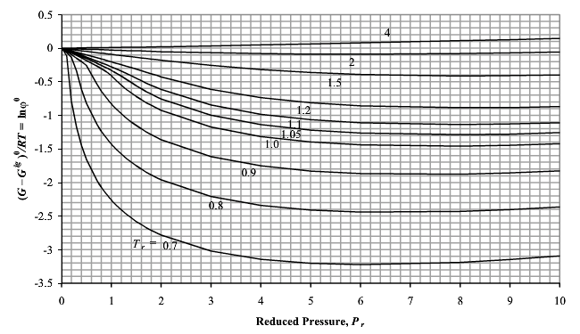
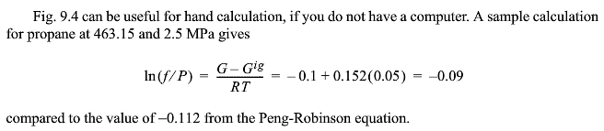
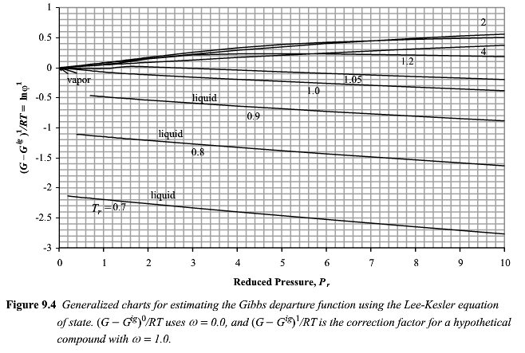

Slide 35
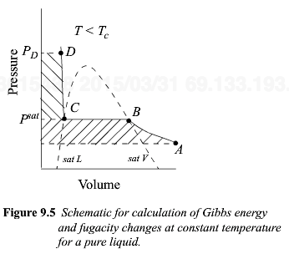

Slide 36

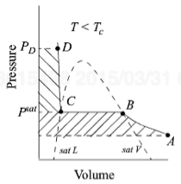

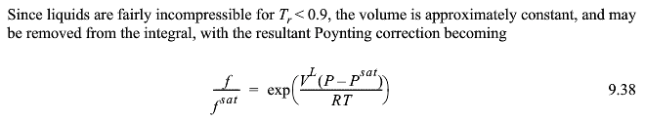


Slide 37
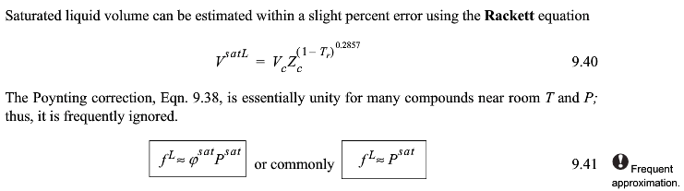


Slide 38




Slide 39
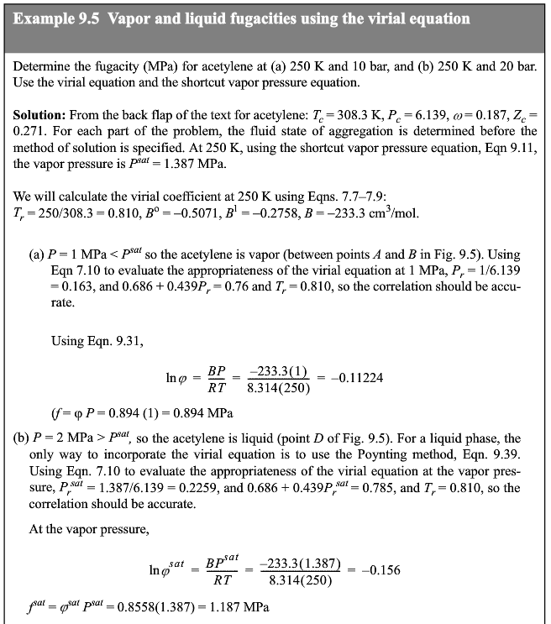
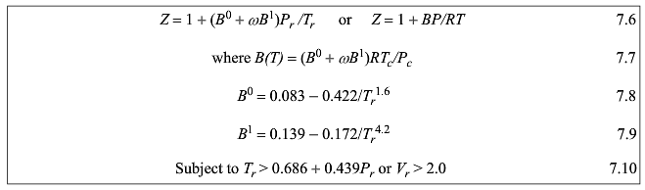
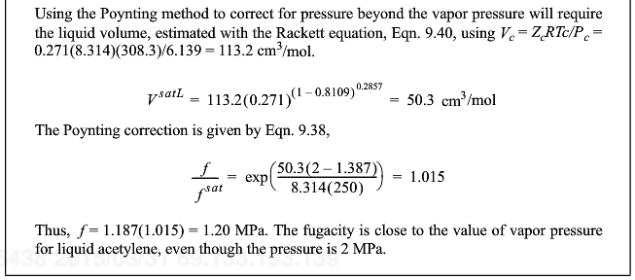



Slide 40
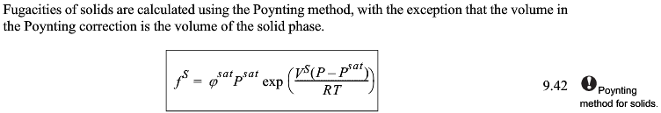


Slide 41

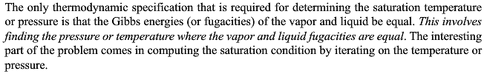

Slide 42
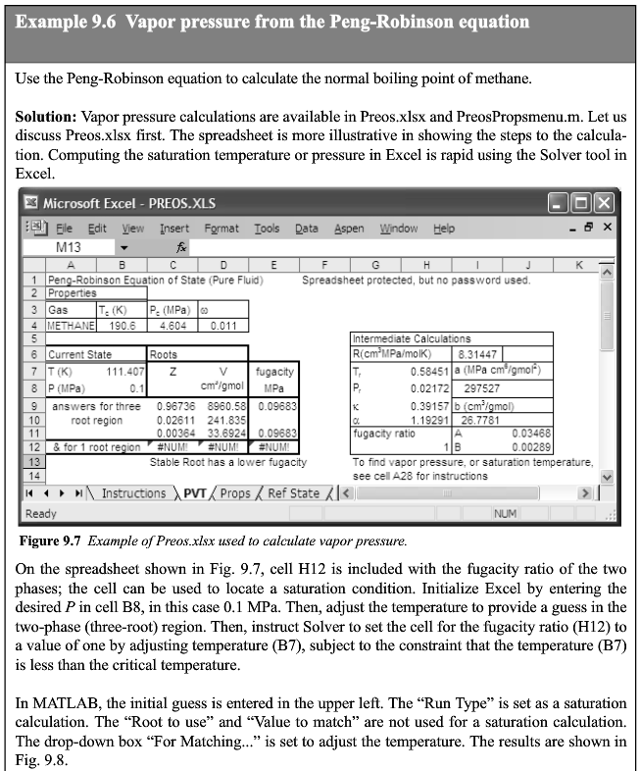
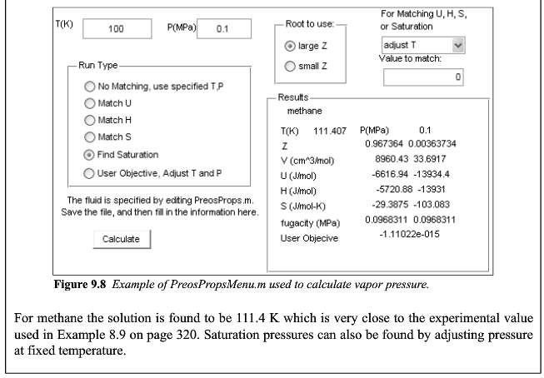

Slide 43
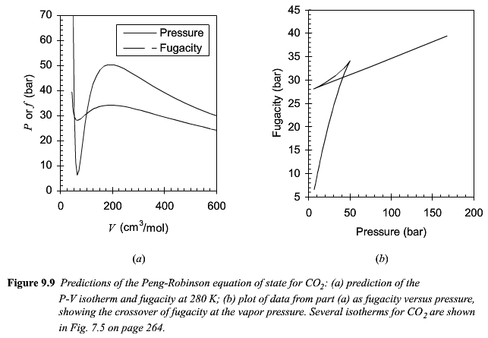

Slide 44
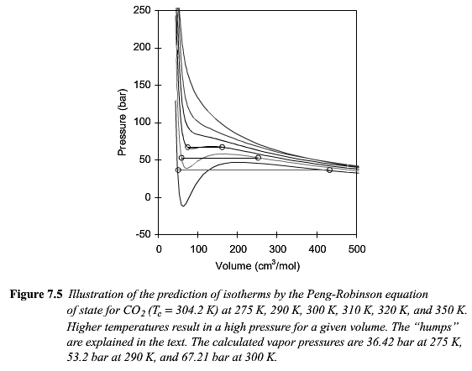

Slide 45
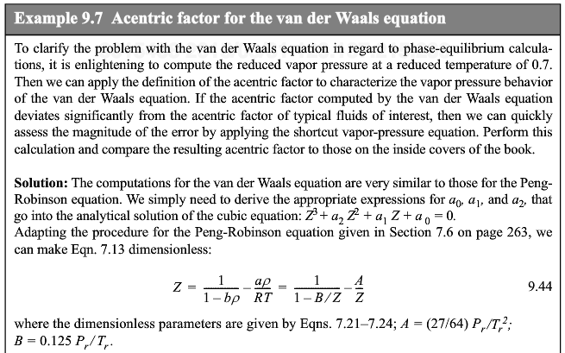


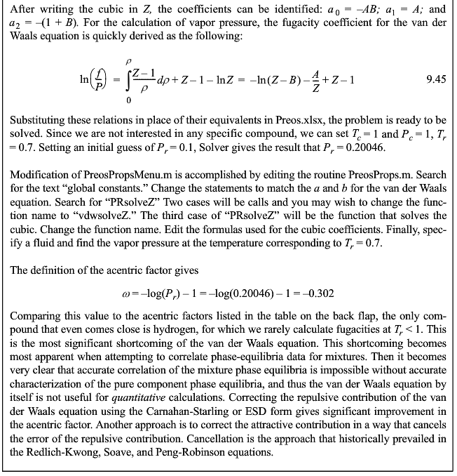




Slide 46




Slide 48


Slide 49

P₀ = (P_{max}+P_{min})/2

Slide 50



Slide 51


Slide 52



Slide 53


Slide 54


